Slide 1
COSC1127/1125 Artificial Intelligence
Prolog Lab
Semester 2, 2025 Prof. Sebastian Sardiña
Designed and Delivered by Harry Porter (Tutor)
Associated repository!

Slide 2
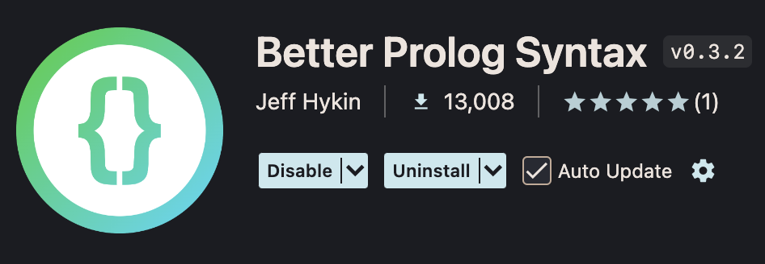
Setup: Visual Studio Code
Install “Better Prolog Syntax”!
Configure Visual Studio Code to interpret the `.pl` extension as Prolog files (otherwise it may conflict with Perl files). One method is to add this to your user settings.json file:
"files.associations": { "*.pl": "prolog" }

Slide 3
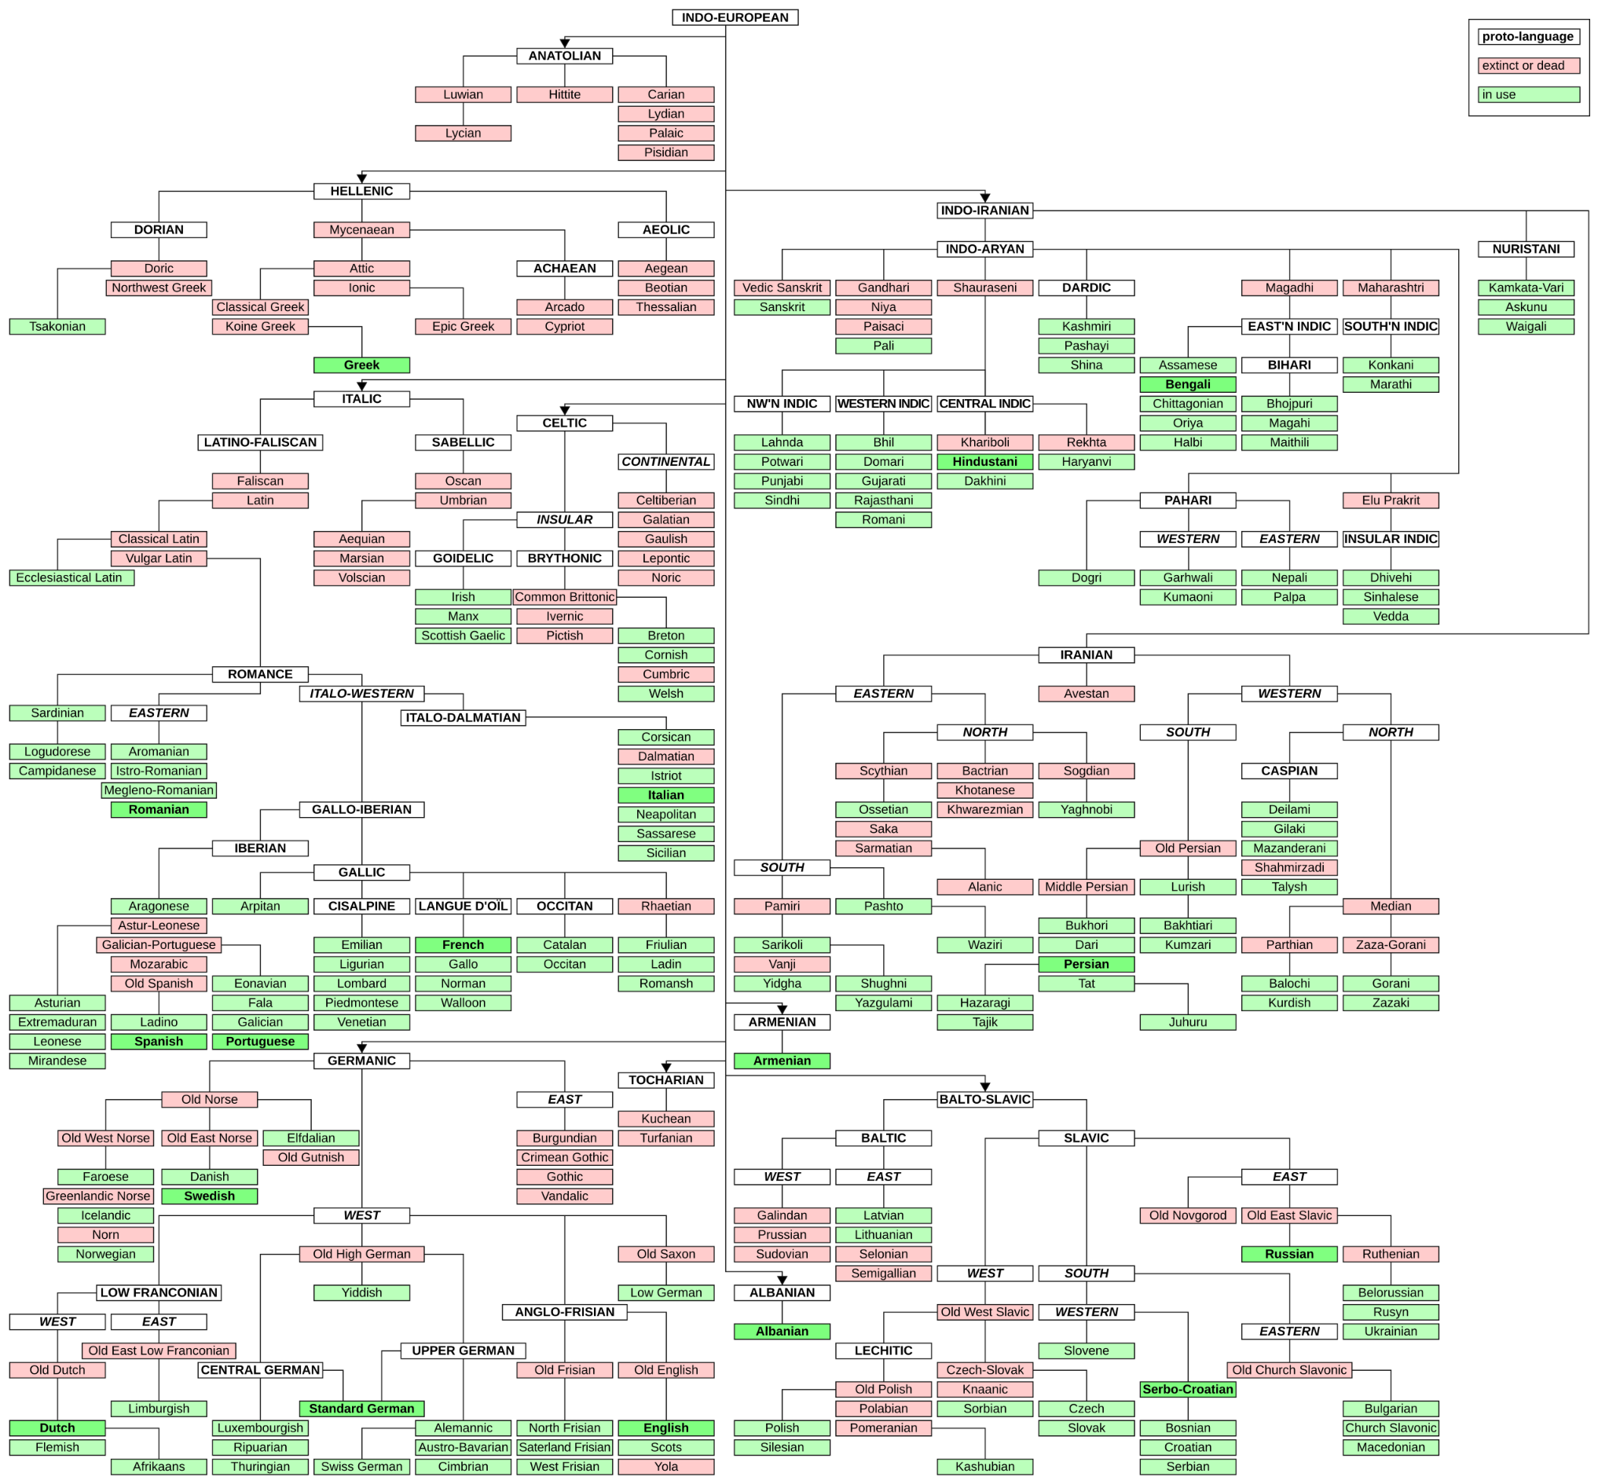
Knowledge Base
Separate knowledge from reasoning processes!
This language family tree denotes four pieces of information—which languages are:
Attested, where speakers or written records exist (green and red nodes).
Unattested, which have been reconstructed from their children (white nodes).
Extinct, where there are no living speakers (red nodes).
Descendants of a given parent language (edges).
Image source!

Slide 4
Propositional Logic: Facts
Prolog programs are queries over databases of facts.
Each fact (or atom) represents a proposition—an assertion that something is true.
Facts start with a lower-case letter.
Statements end with a full-stop.
% Refer to language_database_propositional.pl!
english_is_language.
spanish_is_language.
classical_latin_is_extinct.

Slide 5
Propositional Logic: Queries
Queries ask whether or not some assertion holds, given the knowledge base.
$ swipl
?- consult("language_database_propositional.pl"). % Add database to the KB.
true.
?- english_is_language.
true.

Slide 6
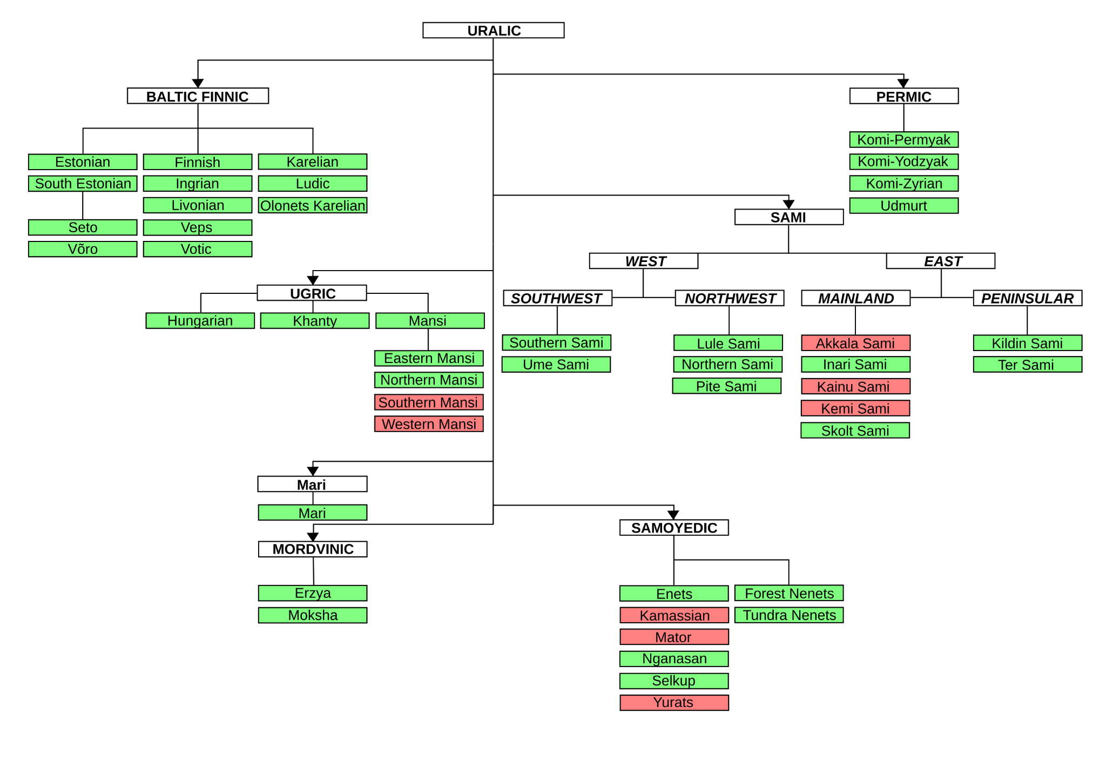
baltic_finnic_is_parent_of_estonian
uralic_is_proto_language
hungarian_is_language
yurats_is_extinct
Image source!

Slide 7
First-order Logic: Predicates
Predicates represent information with more structure than propositions.
They are defined by their functor and arity.
functor/arity
is_parent/2 denotes the predicate with functor isParent and 2 arguments, for example: is_parent('Old West Norse', 'Icelandic')
Atoms can be 'quoted' inside terms, or begin with a lower-case letter
We can represent our family trees using four predicates:
is_language/1 means the language is attested
is_proto_language/1 means the language is unattested
is_extinct/1 means the language isn't spoken anymore
is_parent/2 means that the latter language evolved from the former
Use language_database_predicates.pl for the following exercises!

Slide 8
is_parent('Baltic Finnic', 'Estonian')
is_parent/2
is_proto_language/1
is_language/1
is_proto_language('Uralic')
is_language('Hungarian')
is_extinct/1
is_extinct('Yurats')
Image source!

Slide 9
Unification
Unification is the process of matching terms to each other, by checking if they can be made equal.
Identical atoms unify
Non-identical atoms don't unify
?- harry = harry.
true.
?- harry = sebastian.
false.

Slide 10
Unification
Identical ground terms also unify.
A ground term contains no variables
?- professor(sebastian, sardiña) = professor(sebastian, sardiña).
true.
?- professor(sebastian, sardiña) = tutor(harry, porter).
false.

Slide 11
Unification: Variables
Variables represent and unify with arbitrary terms.
Variables begin with an uppercase letter
is_parent('Old West Norse', X)
Variables can be instantiated to any value.
Different variables can be unified to produce a single variable.
?- X = harry.
X = harry.
?- X = professor(sebastian, sardiña).
X = professor(sebastian, sardiña).
?- X = Y, Y = harry.
X = Y, Y = harry.

Slide 12
Unification: Variables
Unification instantiates variables.
If a variable occurs multiple times, all instances are unified
Unification can occur in either term being unified
?- X = professor(sebastian, Y), Y = sardiña.
X = professor(sebastian, sardiña),
Y = sardiña.
?- professor(X, sardiña) = professor(sebastian, Y).
X = sebastian,
Y = sardiña.
?- professor(sebastian, sardiña), professor(X, X). % Why will this fail?

Slide 13
Unification: Queries
Prolog attempts to unify queries with some part of the knowledge base.
If it is successfully unified, the query is true.
Every possible unification is returned, one by one.
$ swipl
?- consult("language_database_predicates.pl"). % Update your knowledge base.
true.
?- is_parent('Old West Norse', X).
X = 'Faroese' ;
X = 'Greenlandic Norse' ;
X = 'Icelandic' ;
X = 'Norn' ;
X = 'Norwegian'.

Slide 14
Rules
Rules derive new facts from the existing knowledge base.
Our knowledge base contains the predicate is_parent/2—what if we want to derive the opposite: is_child/2?
is_parent('Achaean', 'Arcado').
is_parent('Achaean', 'Cypriot').
is_parent('Aeolic', 'Aegean').
% Etc.

Slide 15
Rules is_child/2
True if language X is the child of language Y.
Queries are unified against the head; if the body holds, the head is true.
isChild(X, Y) :- isParent(Y, X).
Head
Body

Slide 16
Rules is_child/2
Add is_child/2 to the knowledge base, then:
?- consult('language_database_predicates.pl').
true.
?- consult('<your-prolog-file>.pl'). % Should contain the `is_child/2` rule.
true.
?- is_child('English', X).
X = 'Old English'.
?- is_child(X, 'Old English').
X = 'English' ; % Type `;` to request another unification.
X = 'Scots' ;
X = 'Yola'.

Slide 17
Rules is_spoken/1
True if language X is still spoken.
is_spoken(X) :- is_language(X), \+ is_extinct(X).
X is spoken IF X is a language AND NOT X is extinct
Every possible unification is tried for each term in the body—backtracking!

Slide 18
Rules is_sibling/2
True if language X is the sibling of language Y.
is_sibling(X, Y) :- is_parent(Z, X), is_parent(Z, Y), X \= Y.
X and Y are siblings IF Z is a parent of X AND Z is a parent of Y AND X and Y do not unify
Why is this required?

Slide 19
Rules is_cousin/2
True if languages X and Y are cousins.
is_cousin(X, Y) :-
is_parent(A, X),
is_parent(B, Y),
is_sibling(A, B),
X \= Y.
X and Y are cousins IF
A is a parent of X AND
B is a parent of Y AND
A and B are siblings AND
X and Y do not unify

Slide 20
Rules is_grandparent/2
True if language X is a grandparent of language Y.
is_grandparent(X,Y) :-
is_parent(X,Z),
is_parent(Z,Y).
X is a grandparent of Y IF
X is a parent of Z AND
Z is a parent of Y

Slide 21
Recursion is_ancestor/2
True if language X is an ancestor of language Y.
is_ancestor(X, Y) :- isParent(X, Y).
X is an ancestor of Y IF X is a parent of Y OR
is_ancestor(X, Y) :-
is_parent(X, Z),
is_ancestor(Z, Y).
X is an ancestor of Y IF
X is a parent of Z AND
Z is an ancestor of Y
CHALLENGE: try to write is_descendant/2. It should be very similar to is_ancestor/2!

Slide 22
Rules share_ancestor/3
True if languages X and Y share an ancestor Z.
share_ancestor(X, Y, Z) :-
is_ancestor(Z, X),
is_ancestor(Z, Y),
X \= Y.
X and Y share an ancestor Z IF
Z is an ancestor of X AND
Z is an ancestor of Y AND
X and Y do not unify
This rule returns every shared ancestor! What if we only want the most recent ancestor?

Slide 23
Rules share_recent_ancestor/3
True if languages X and Y share an ancestor A and no children of A are ancestors of both X and Y
share_recent_ancestor(X, Y, A) :-
share_ancestor(X, Y, A),
\+ (
is_parent(A, B),
share_ancestor(X, Y, B)
).
A is the most recent ancestor of X and Y IF
A is a shared ancestor of X and Y AND
NOT
A is the parent of B AND
B is a shared ancestor of X and Y
Negation applied to entire parenthesised expression!
CHALLENGE: What is \+ (is_parent(A, B), share_ancestor(X, Y, B)) equivalent to by De Morgan’s Law?

Slide 24
Lists
Lists are ordered collections of terms.
[alan, turing, ada, lovelace, claude, shannon]

Slide 25
Lists
They can be unified into their head (the first element) and tail (a list containing all subsequent elements).
[alan | turing, ada, lovelace, claude, shannon]
HEAD
TAIL

Slide 26
Unification: Lists
Lists unify according to their elements.
They can be unified into their head and tail.
?- [X, Y] = [ada, lovelace].
X = ada,
Y = lovelace.
?- [H | T] = [ada, lovelace, claude, shannon].
H = ada,
T = [lovelace, claude, shannon].
?- [X, Y | T] = [ada, lovelace, claude, shannon].
X = ada,
Y = lovelace,
T = [claude, shannon].

Slide 27
Unification: Lists
Empty lists only unify with themselves.
?- [] = [].
true.
?- [] = [claude, shannon].
false.
?- [X] = [turing].
X = turing.
?- [X] = [X | []]. % Lists with length 1 have an `[]` tail.
true.
?- [X] = [ada, lovelace]. % Why does this unification fail?
false.

Slide 28
List Operations
Let’s rewrite some built-in list operation predicates!
?- member(ada, [claude, shannon, ada, lovelace]).
true.
?- length([claude, shannon, ada, lovelace], N).
N = 4.
?- append([ada, lovelace], [alan, turing], X).
X = [ada, lovelace, alan, turing].

Slide 29
List Operations has_size/2
Our version of the built-in length/2 predicate.
has_size([], 0).
[] has size 0
has_size([_ | T], N) :-
has_size(T, M),
N is M + 1.
A list with tail T has size N IF
T has size M AND
N equals M + 1
`_` is an anonymous variable. Use it when a variable is only referenced once, so it doesn't need a name.
REMEMBER: Different cases for the same rule should generally be mutually exclusive!

Slide 30
List Operations contains/2
Our version of the built-in member/2 predicate.
contains([X | _], X).
A list with head X contains X
contains([H | T], X) :-
H \= X,
contains(T, X).
A list with head H and tail T contains X IF
H and X do not unify AND
T contains X
What happens if we query
?- contains([], turing)?

Slide 31
List Operations is_concatenated/3
Our version of the built-in append/3 predicate.
is_concatenated([], L, L).
[] concatenated with a list L is L
is_concatenated([X | A], L, [X | B]) :-
is_concatenated(A, L, B).
A list with head X and tail A concatenated with list L is X prepended to list B IF
List B is A concatenated with L
This one is a bit tricker! Take your time stepping through it with ?- trace. and try different queries!

Slide 32
List Operations are_languages_related/2
What does this predicate do?
are_languages_related([], []).
are_languages_related([languages(X, Y) | A], [related(X, Y) | B]) :-
share_recent_ancestor(X, Y, _),
are_languages_related(A, B).
are_languages_related([languages(X, Y) | A],[unrelated(X, Y) | B]) :-
\+ share_recent_ancestor(X, Y, _),
are_languages_related(A, B).
Why have I used share_recent_ancestor/3 and not simply share_ancestor/3?
CHALLENGE: Exclude any terms that do not unify with languages/2 from the output list.

Slide 33
List Knowledge Base
We can represent our is_parent/2 predicate using lists!
Use languages_database_lists.pl for the following exercises.
% Predicates like this:
is_parent('Old East Norse', 'Swedish').
is_parent('Old East Norse', 'Danish').
% Can be expressed like this:
is_parent('Old East Norse', ['Swedish', 'Danish']).

Slide 34
Mutual Recursion has_descendants/2
List all the descendants of language X, assuming languages are their own descendants!
has_descendants(X, [X]) :-
\+ is_parent(X, _).
has_descendants(X, [X | Y]) :-
isParent(X, Z),
have_descendants(Z, Y).
have_descendants([], []).
have_descendants([X | Y], Z) :-
has_descendants(X, A),
have_descendants(Y, B),
is_concatenated(A, B, Z).
[] has descendants []
A list with head X and tail Y has descendants Z IF
X has descendants A AND
Y has descendants B AND
Concatenating A and B yields Z
CHALLENGE: Annotate has_descendants/2!

Slide 35
Mutual Recursion has_spoken_descendants/3
Count all non-extinct descendants of a language X, assuming languages are their own descendants!
has_spoken_descendants(X, 0) :- \+ is_parent(X, _), is_extinct(X).
has_spoken_descendants(X, 1) :- \+ is_parent(X, _), \+ is_extinct(X).
has_spoken_descendants(X, N) :-
is_parent(X, Y),
is_extinct(X),
have_spoken_descendants(Y, N).
has_spoken_descendants(X, N) :-
is_parent(X, Y),
\+ is_extinct(X),
have_spoken_descendants(Y, M),
N is M + 1.
CHALLENGE: Implement have_spoken_descendants/3! Refer to have_descendants/2 on the previous slide.

Slide 36
Finished!

